Slide 1
ROAD ACCIDENT TRANSPORTATION
MILESTONE 3
TEAM 4
Pavana R
Shaista Sultana
Subasri

Slide 2
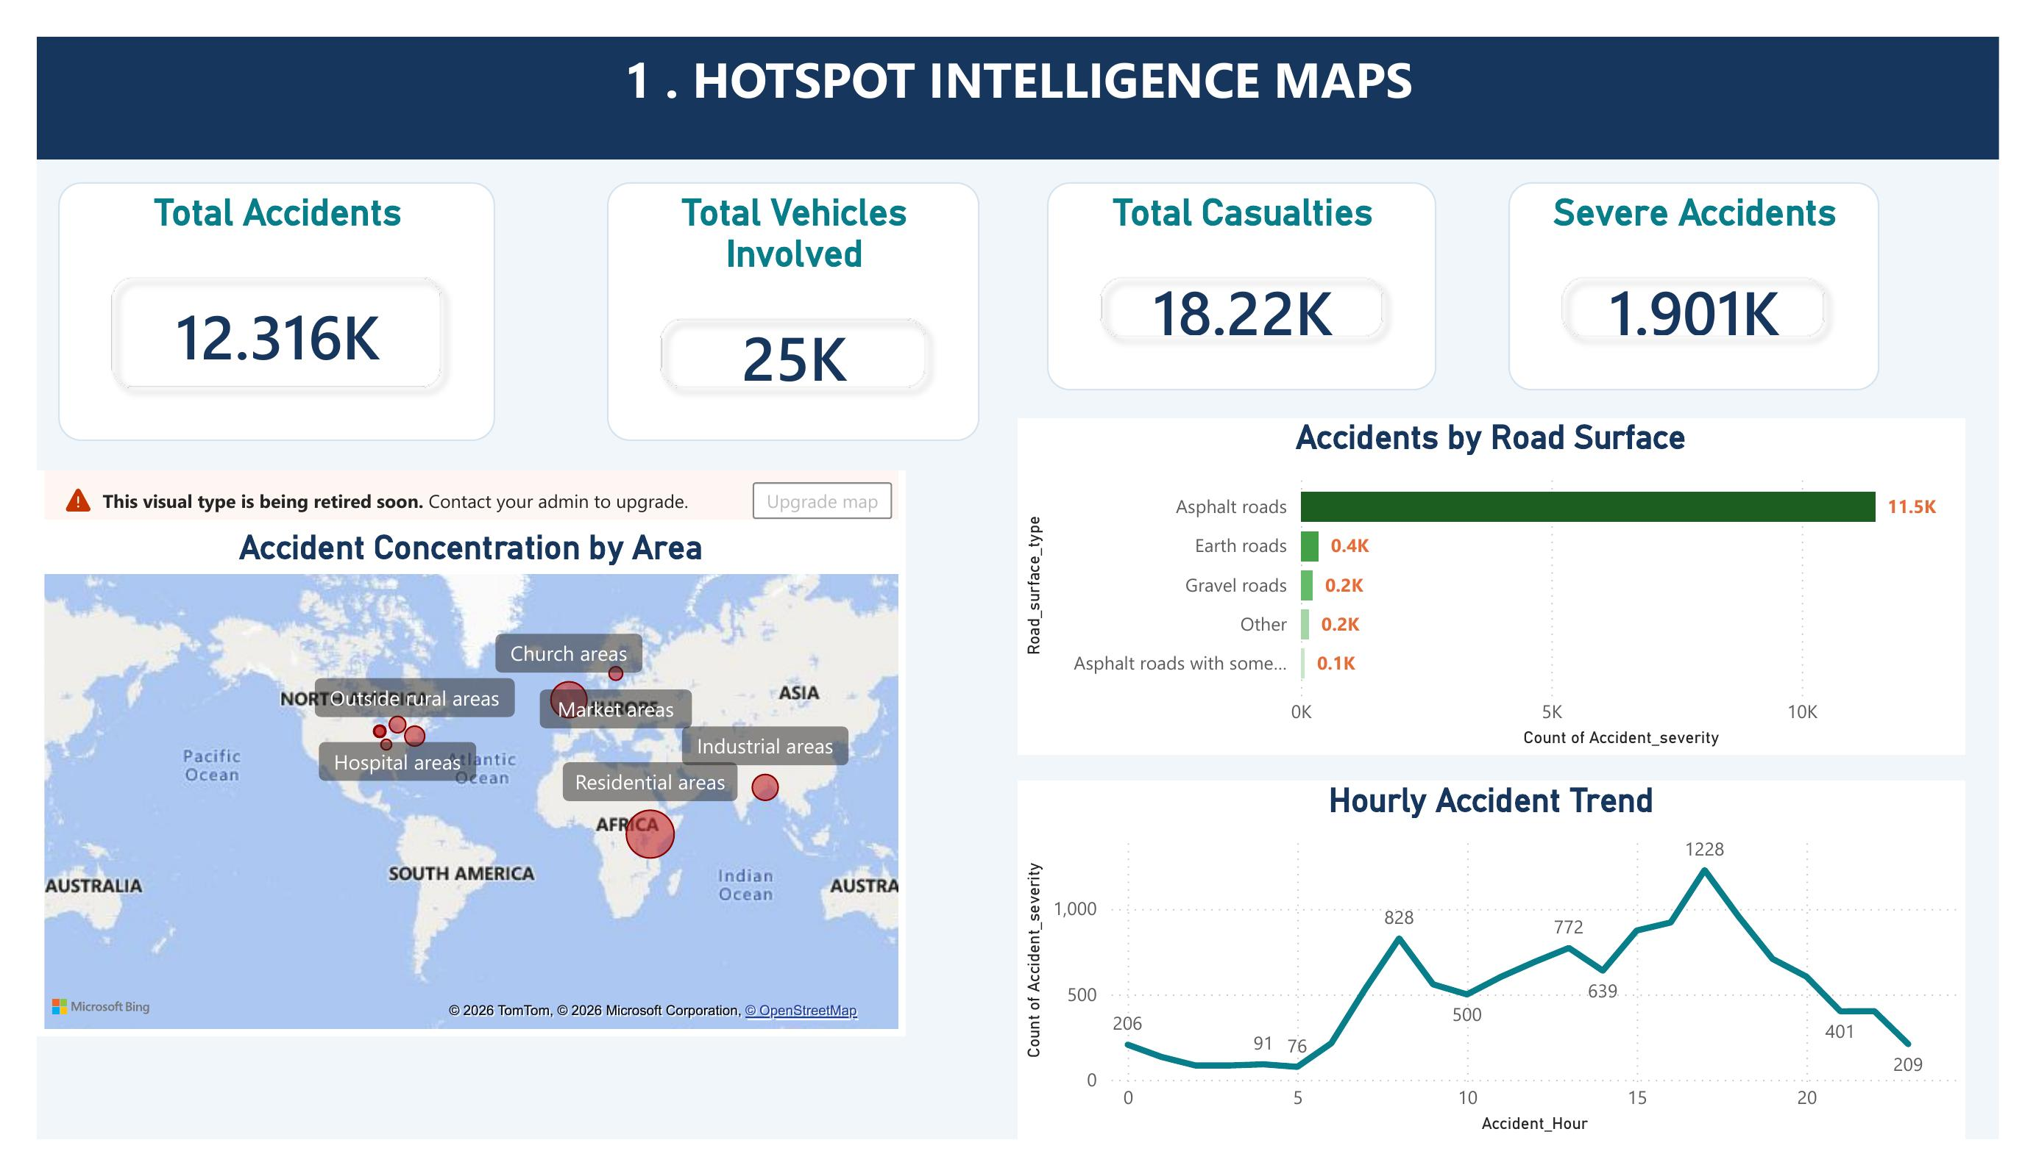
1
HOTSPOT INTELLIGENCE MAPS

Slide 3
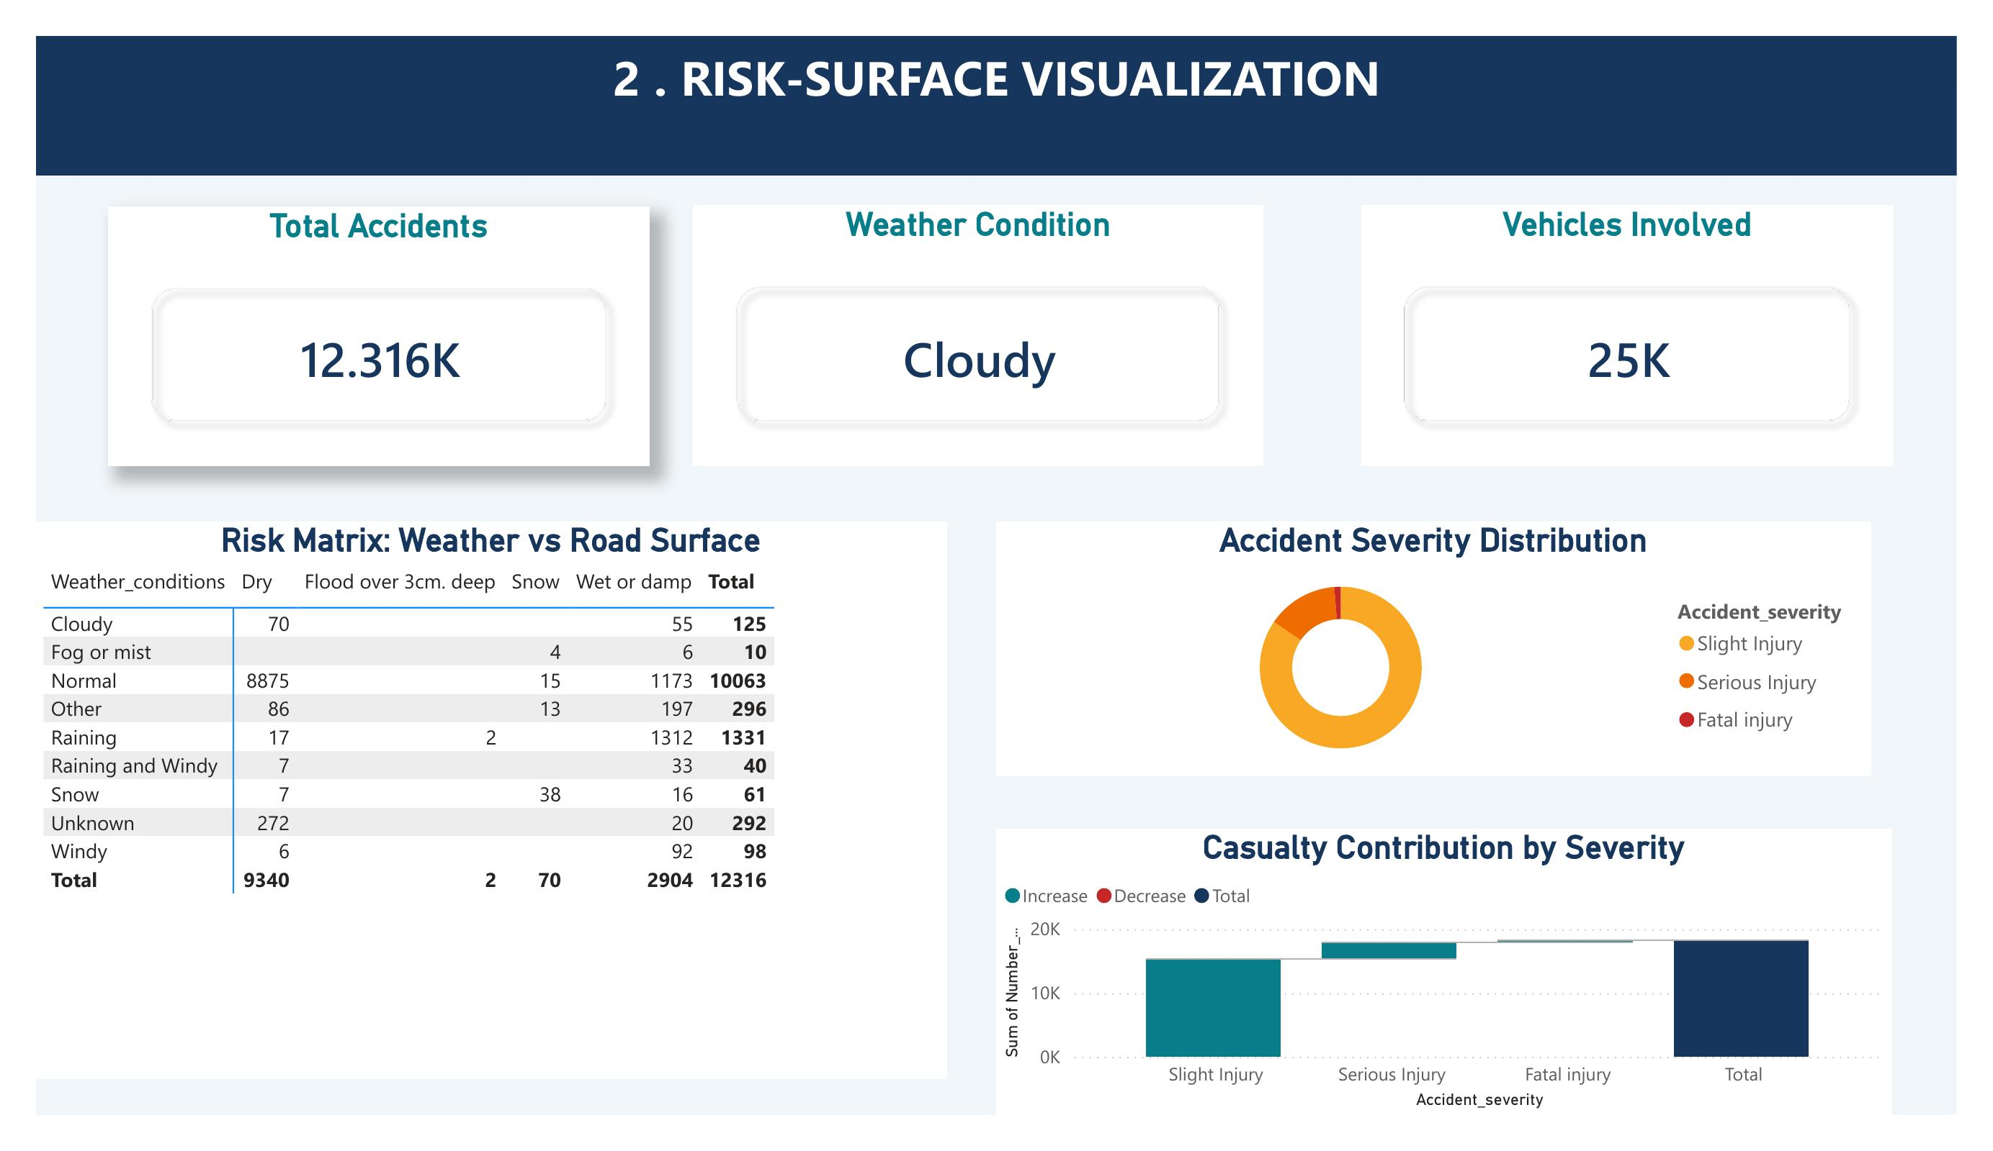
2
RISK-SURFACE VISUALIZATION

Slide 4
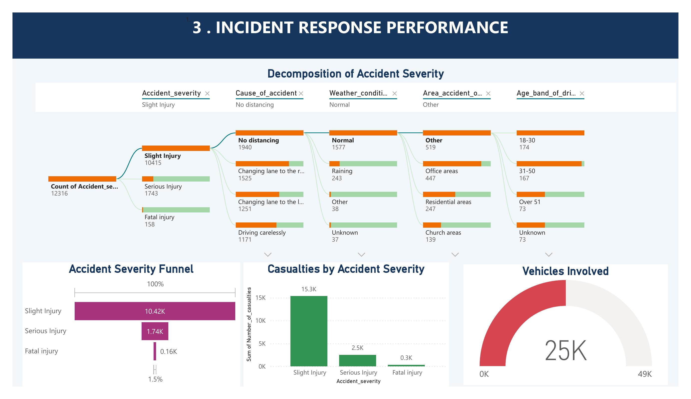
3
INCIDENT RESPONSE PERFORMANCE

Slide 5
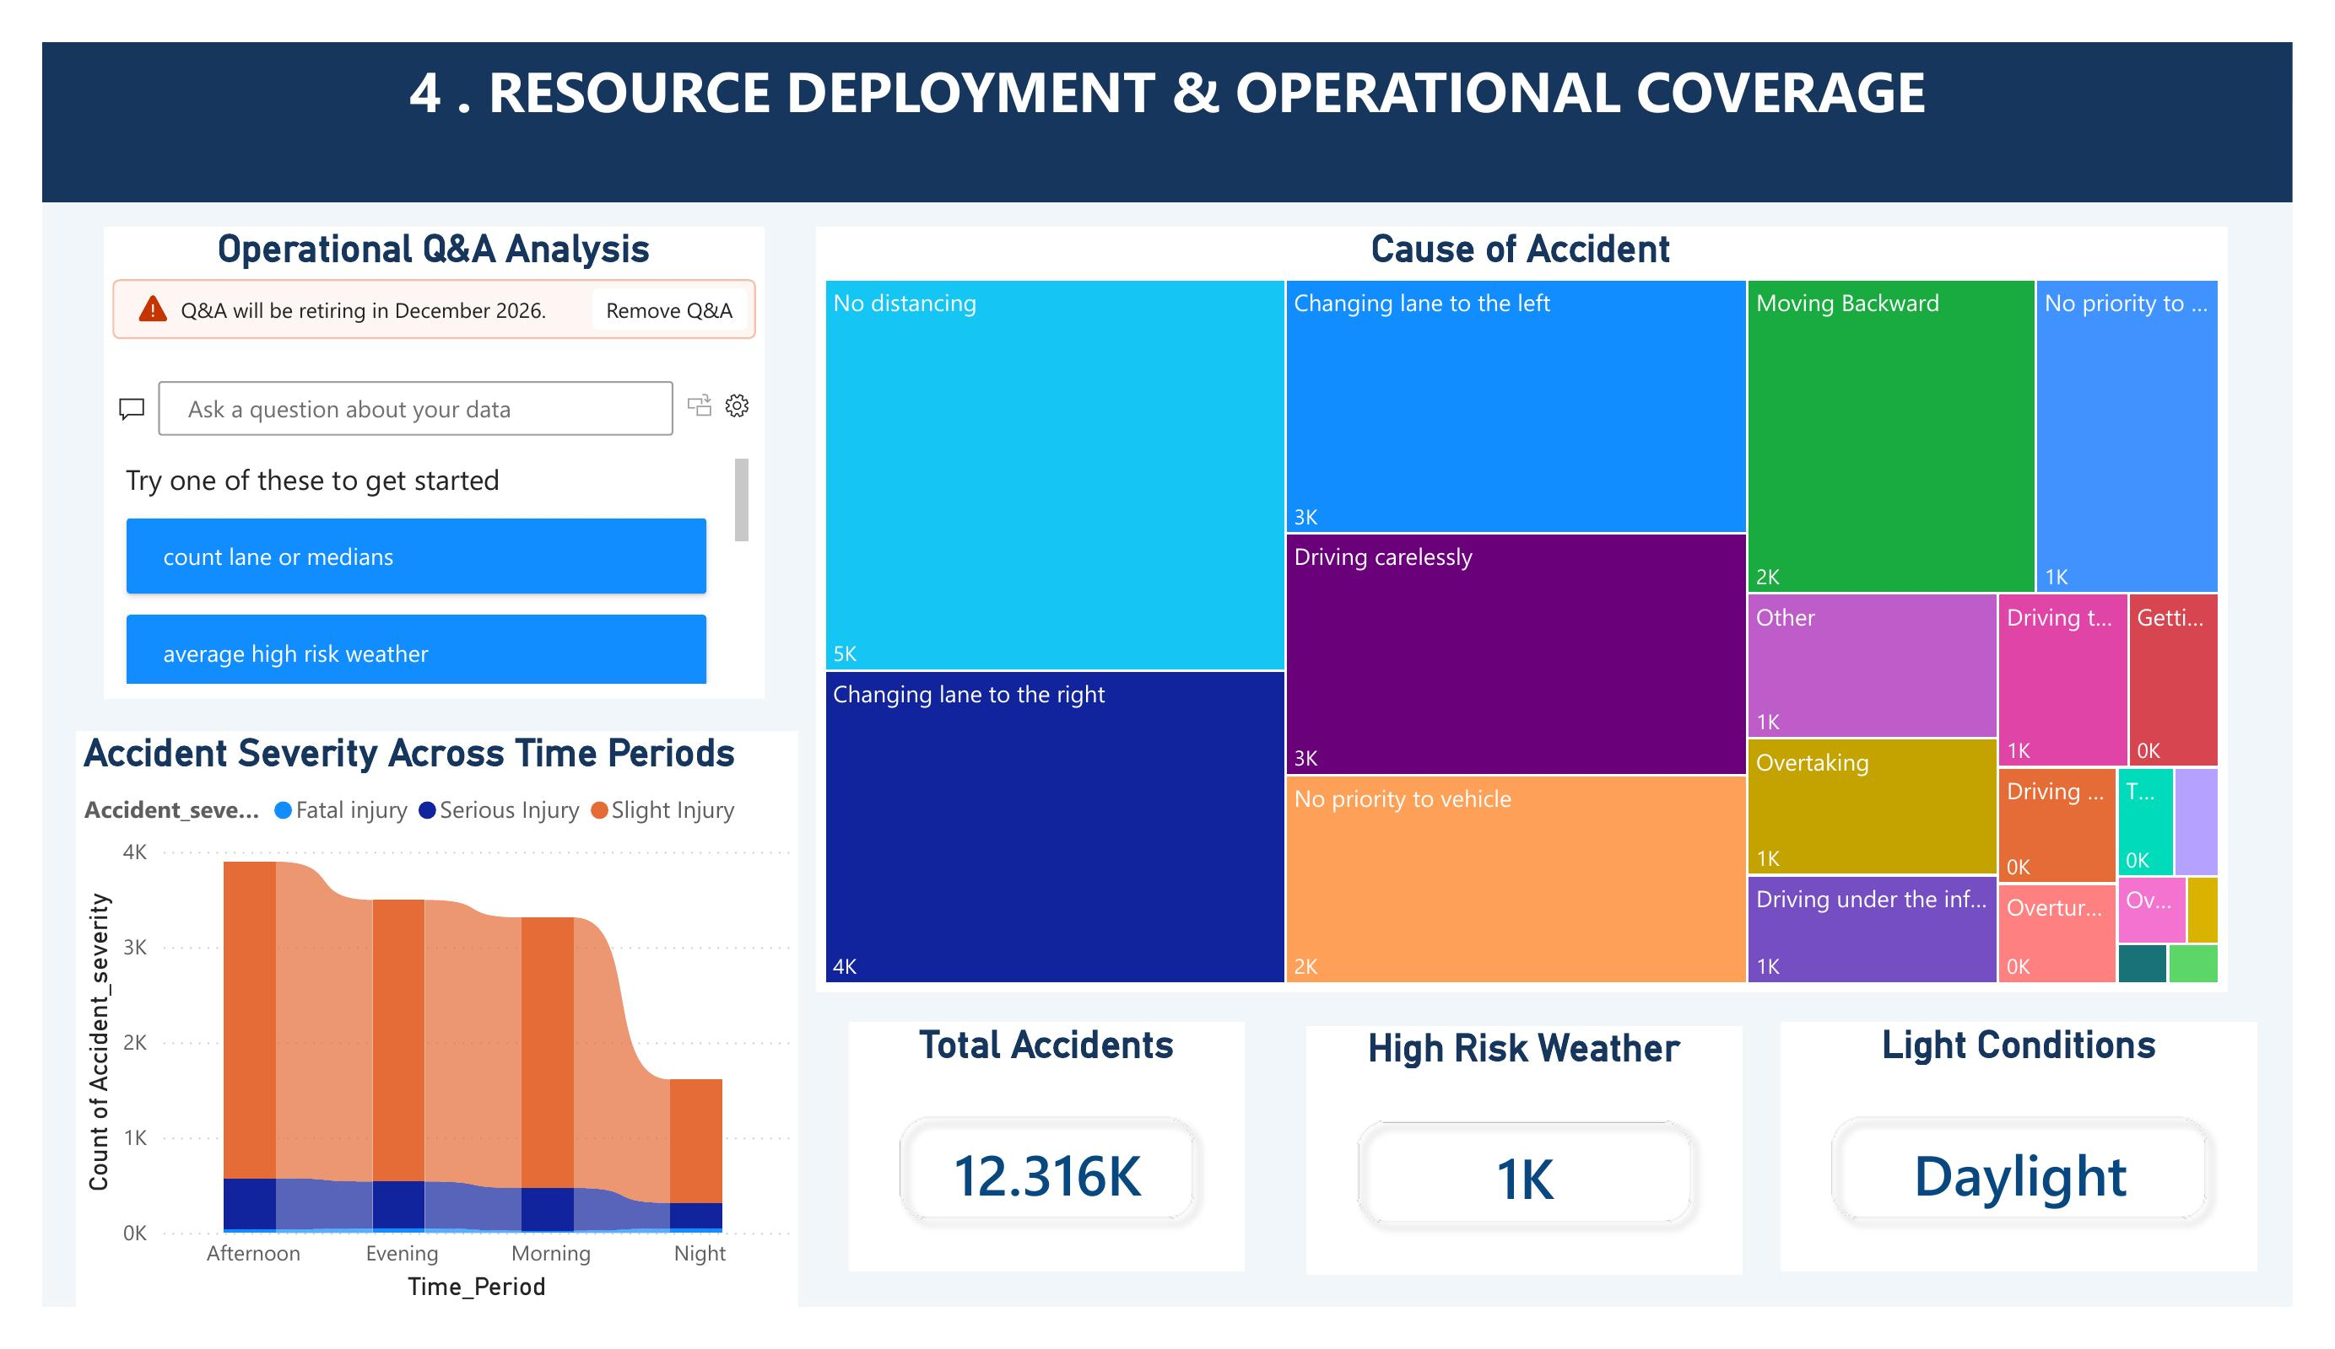
4
RESOURCE DEPLOYMENT & OPERATIONAL COVERAGE

Slide 6
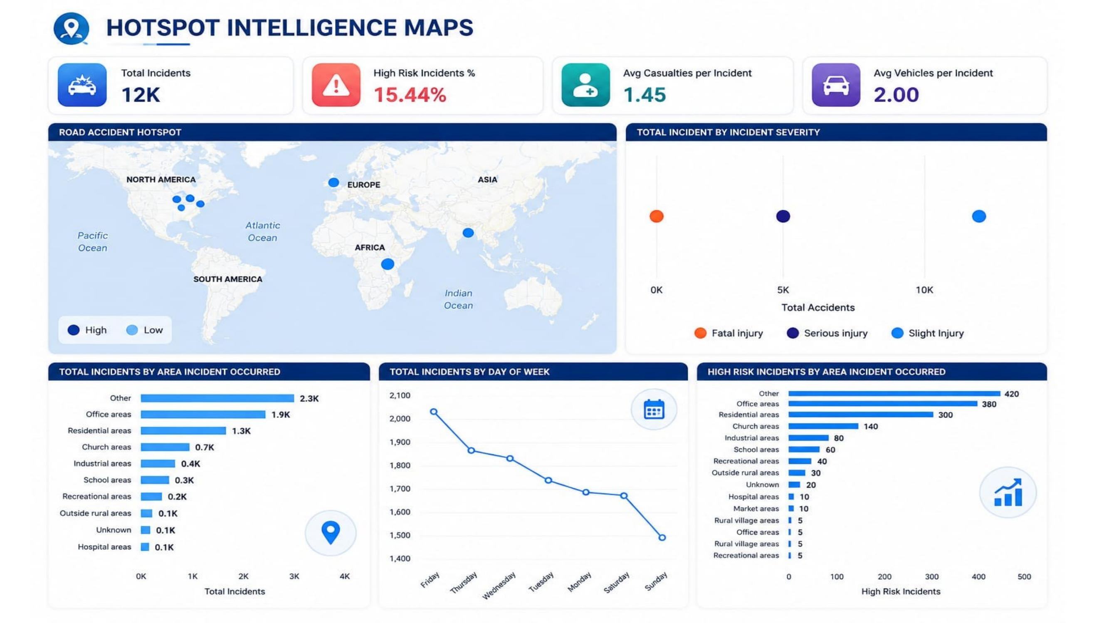
5
HOTSPOT INTELLIGENCE MAPS

Slide 7
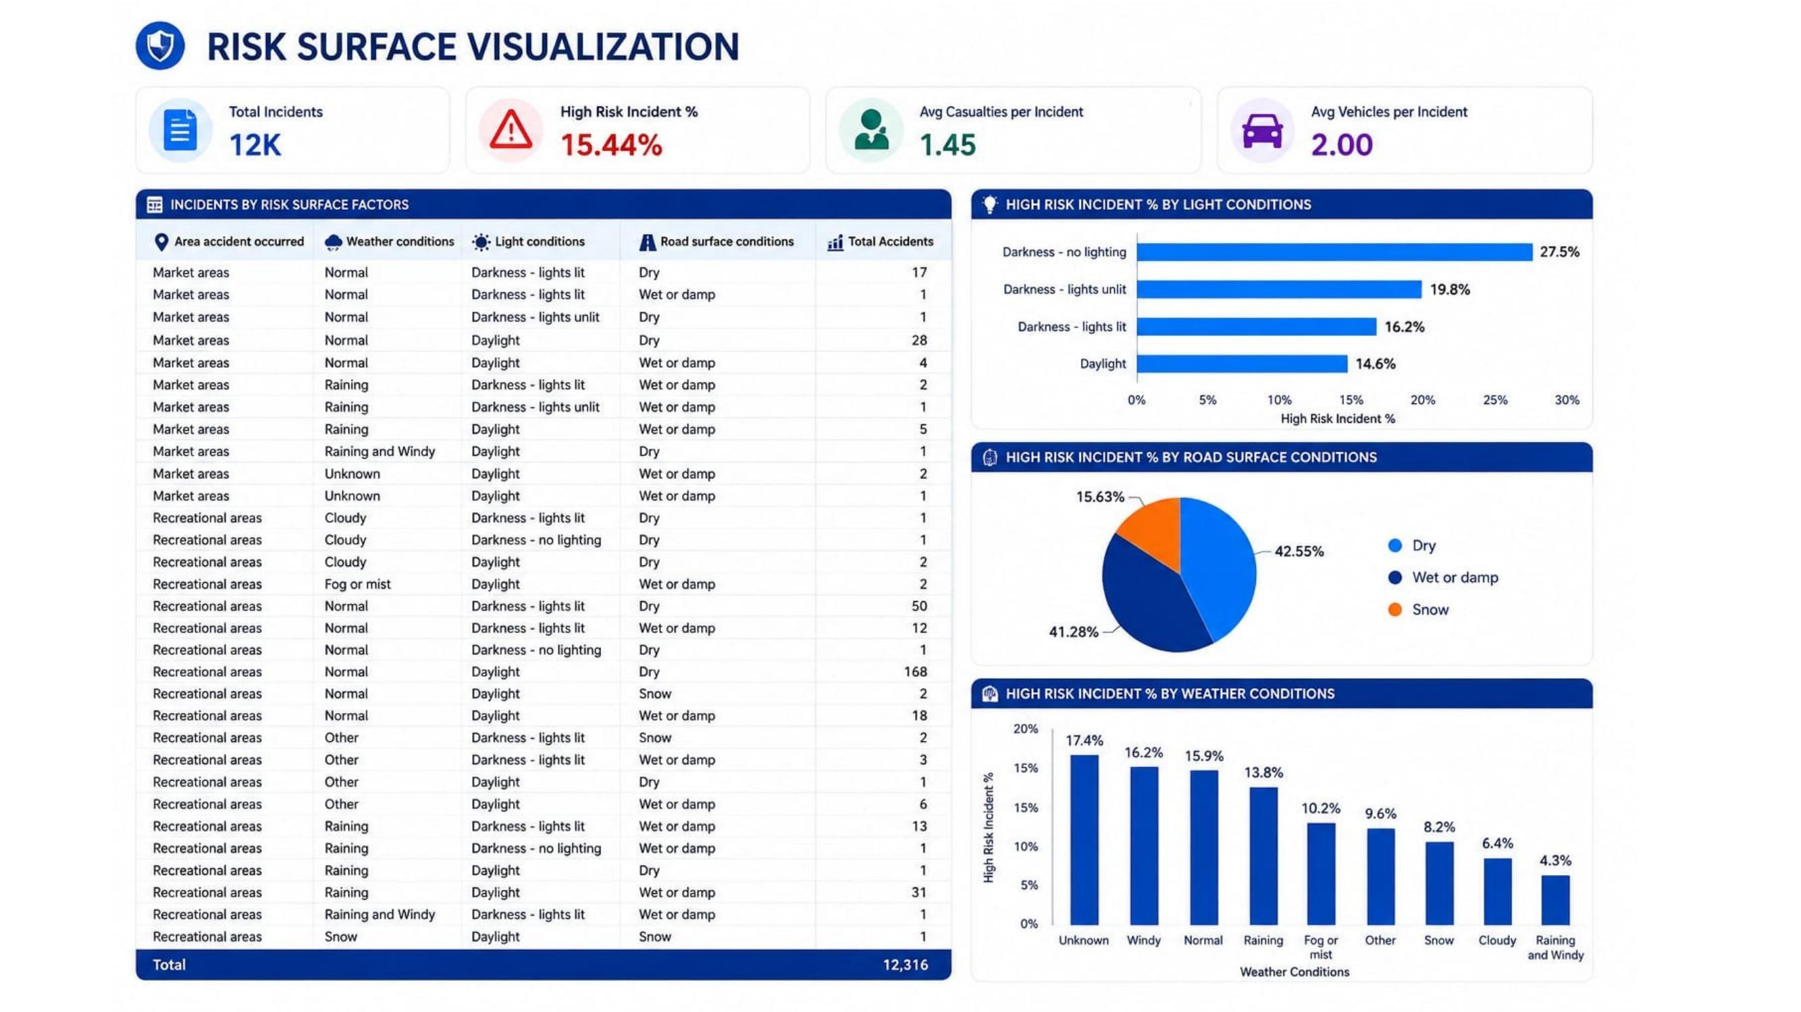
6
RISK SURFACE VISUALIZATION

Slide 8
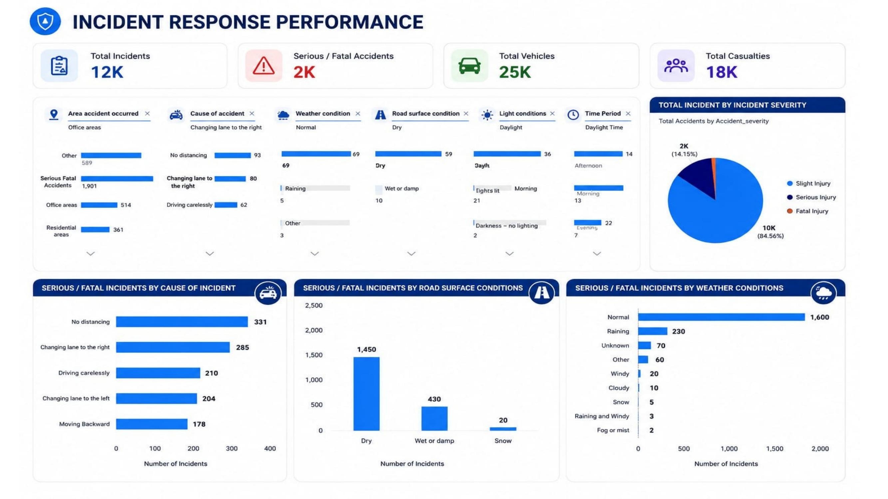
7
INCIDENT RESPONSE PERFORMANCE

Slide 9
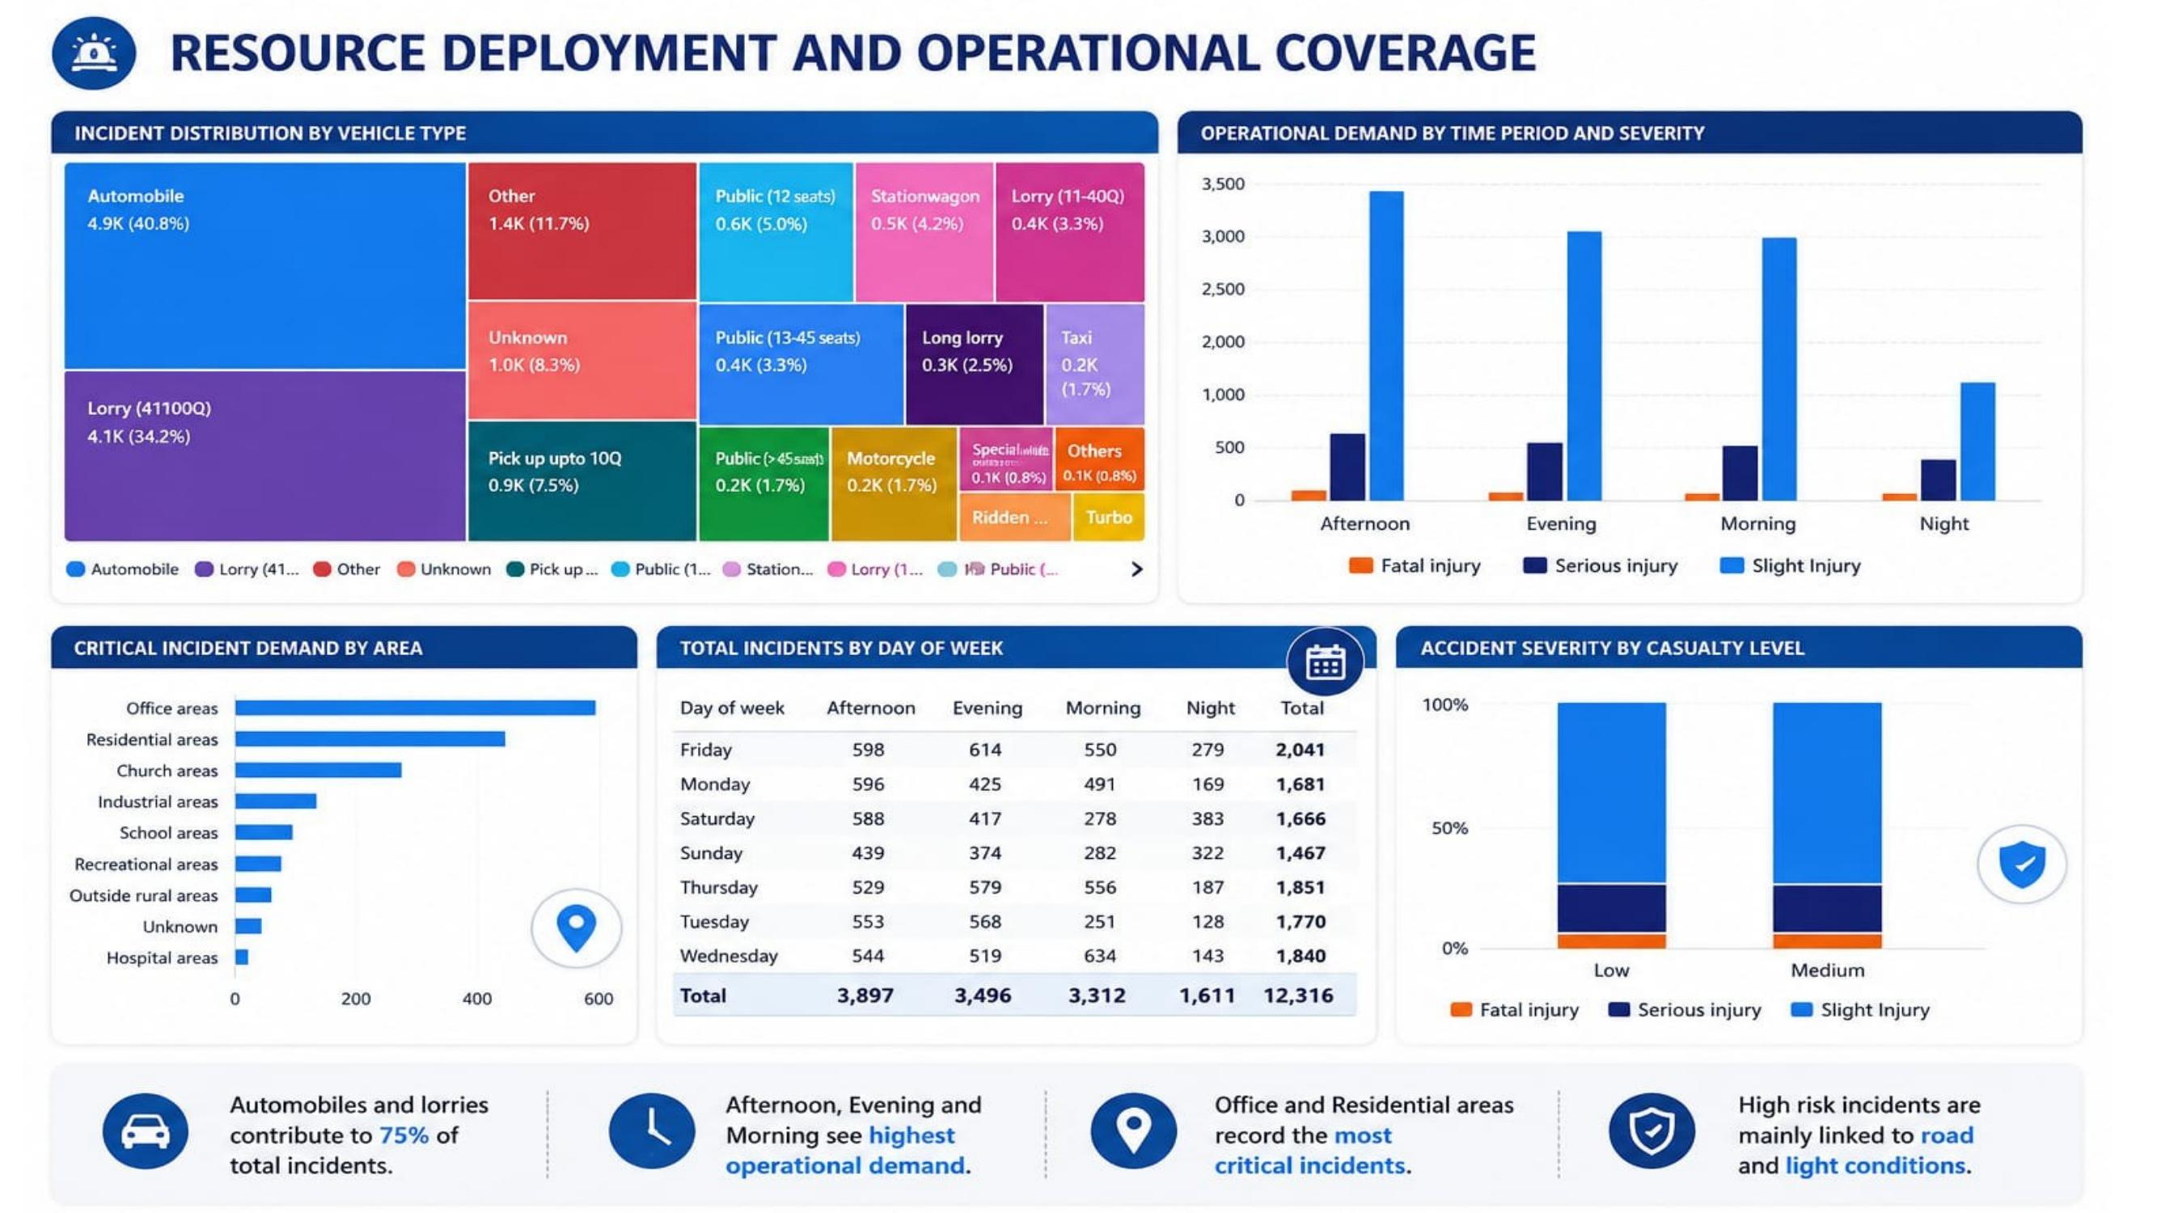
8
RESOURCE DEPLOYMENT & OPERATIONAL COVERAGE

Slide 10
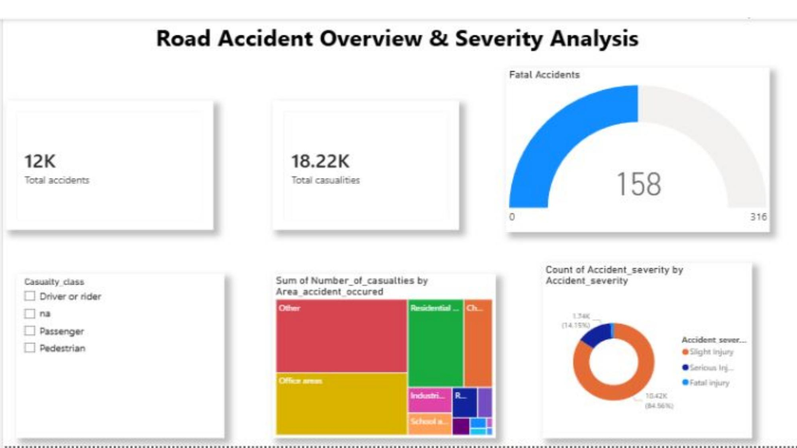
9
ROAD ACCIDENT OVERVIEW & SEVERITY ANALYSIS

Slide 11
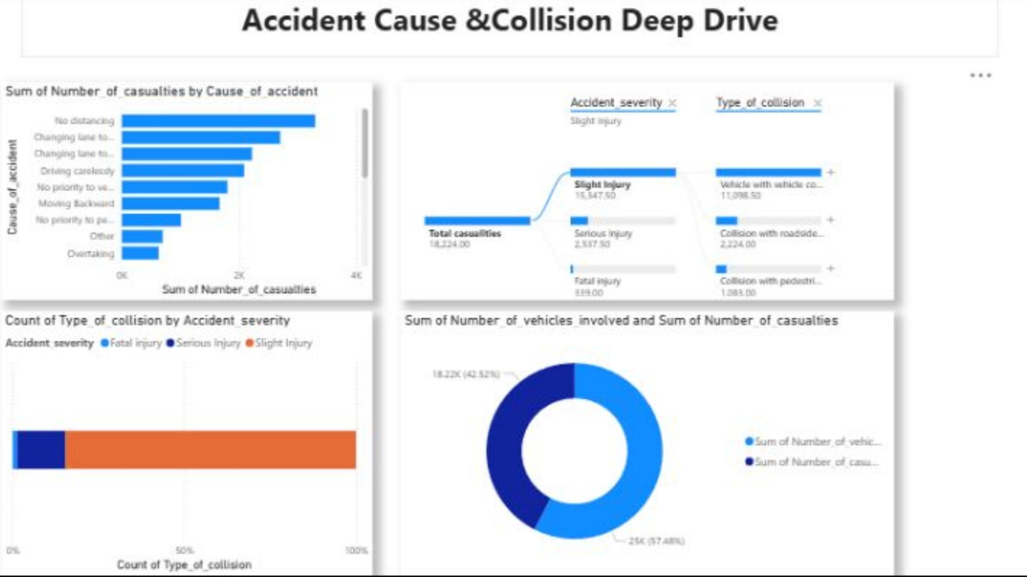
10
ACCIDENT CAUSE & COLLISION DEEP DIVE

Slide 12
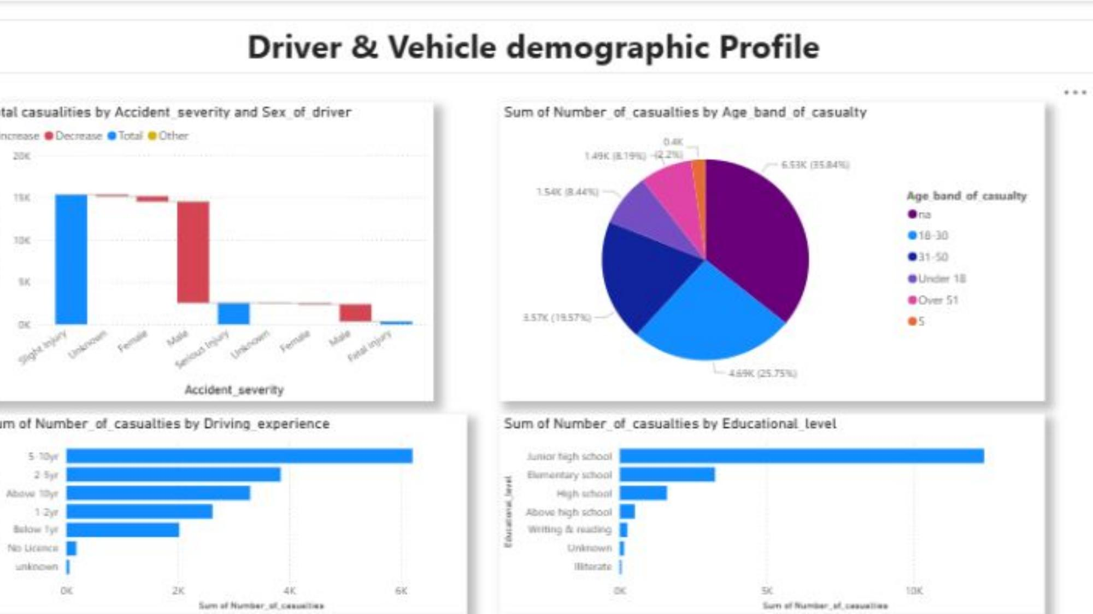
11
DRIVER & VEHICLE DEMOGRAPHIC PROFILE

Slide 13
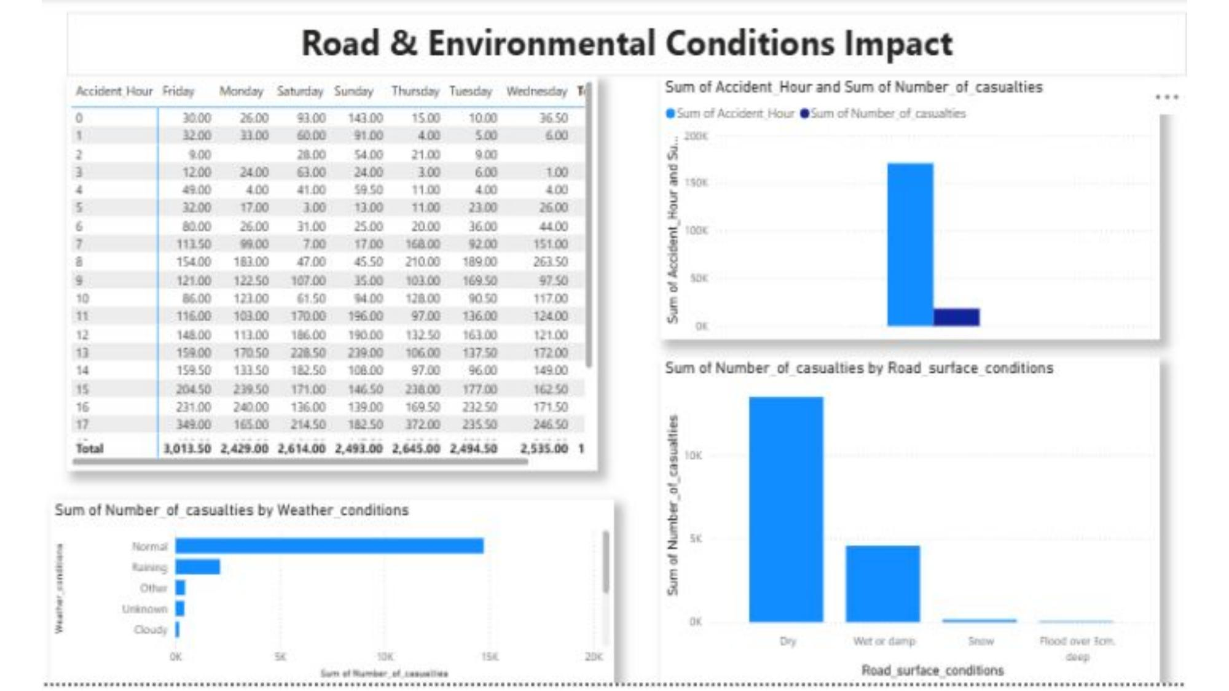
12
ROAD & ENVIRONMENTAL CONDITIONS IMPACT
i

Slide 14
KEY INSIGHTS & CONCLUSION
🚗
Volume & Severity
🛣️
Road & Weather Conditions
12,316 total accidents recorded 18.22K casualties, with Slight Injury dominating at 84.6% and Fatal Injury at just 1.5% of cases.
Asphalt roads account for 11.5K (93%) of accidents; Normal weather and Dry surfaces see the highest incident counts, not adverse conditions.
⏰
Timing Patterns
🚦
Leading Causes
Accidents peak sharply in the evening (around hour 17-18, ~1,228 incidents) and are lowest between 2-5 AM; Friday records the most incidents by day.
No distancing, changing lanes (left/right), and driving carelessly are the top causes, together driving the majority of casualties.
📍
High-Risk Locations
👤
Driver Demographics
Office and residential areas report the most critical/high-risk incidents, while automobiles and lorries contribute 75% of total incidents.
Drivers aged 18-30 and those with 5-10 years of experience are involved in the highest share of casualties; junior high school is the most common education level.

Slide 15
THANK YOU
Team 4 | Pavana R • Shaista Sultana • Subasri

